Slide 1
Steam - lite
Maxwell Light
&
Roger Lorelli

Slide 2





Problem domain?
What is the problem?
Today there exist numerous platforms to purchase digital rights to games
Why is this a problem?
This leads to disconnected libraries where a person might not remember what is in each library

Slide 3
Problem Domain cont.
What is your solution?
A centralized database that players can add games to which will consolidate their libraries.
Why is it a solution?
By doing this, players will be able to better see what games they currently own, have access to the installed executables, and be able to see what games their friends have, plus the marketplace from which they were purchased.

Slide 4
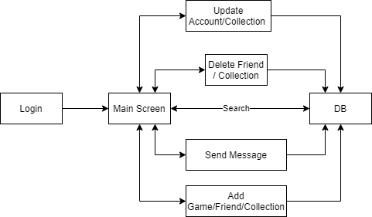
Application
Features
Comprehensive collection of games that exist within multiple online marketplaces.
Personal libraries that track games owned across the same marketplaces.
Customized collections
Able to add other users as friends, being able to see their alias’ across the other marketplaces they use as well as the games they own
Able to send messages to other users.

Slide 5

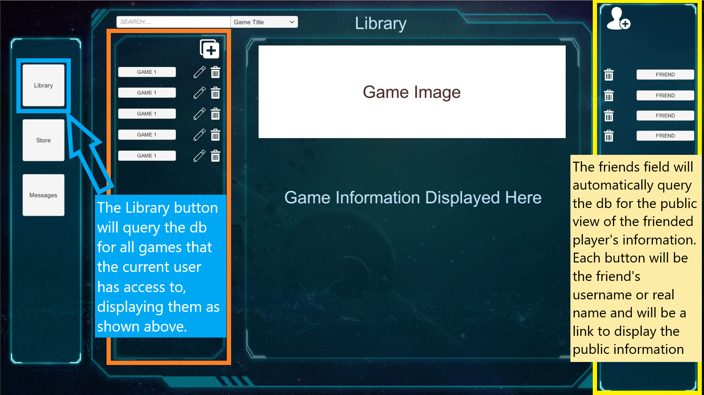
Application - Interaction
The main page will be split into 3 vertically divided sections with the left dedicated to the user’s game library, middle as a main display with a search bar at the top, and the right as a display for a friends list.
Each entry in the library, search results, and friends list will be a button that when clicked will display the information about the game/friend in the middle section.

Slide 6



Technology

Slide 7
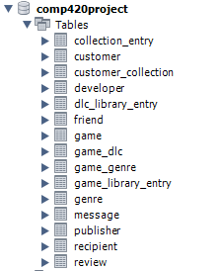
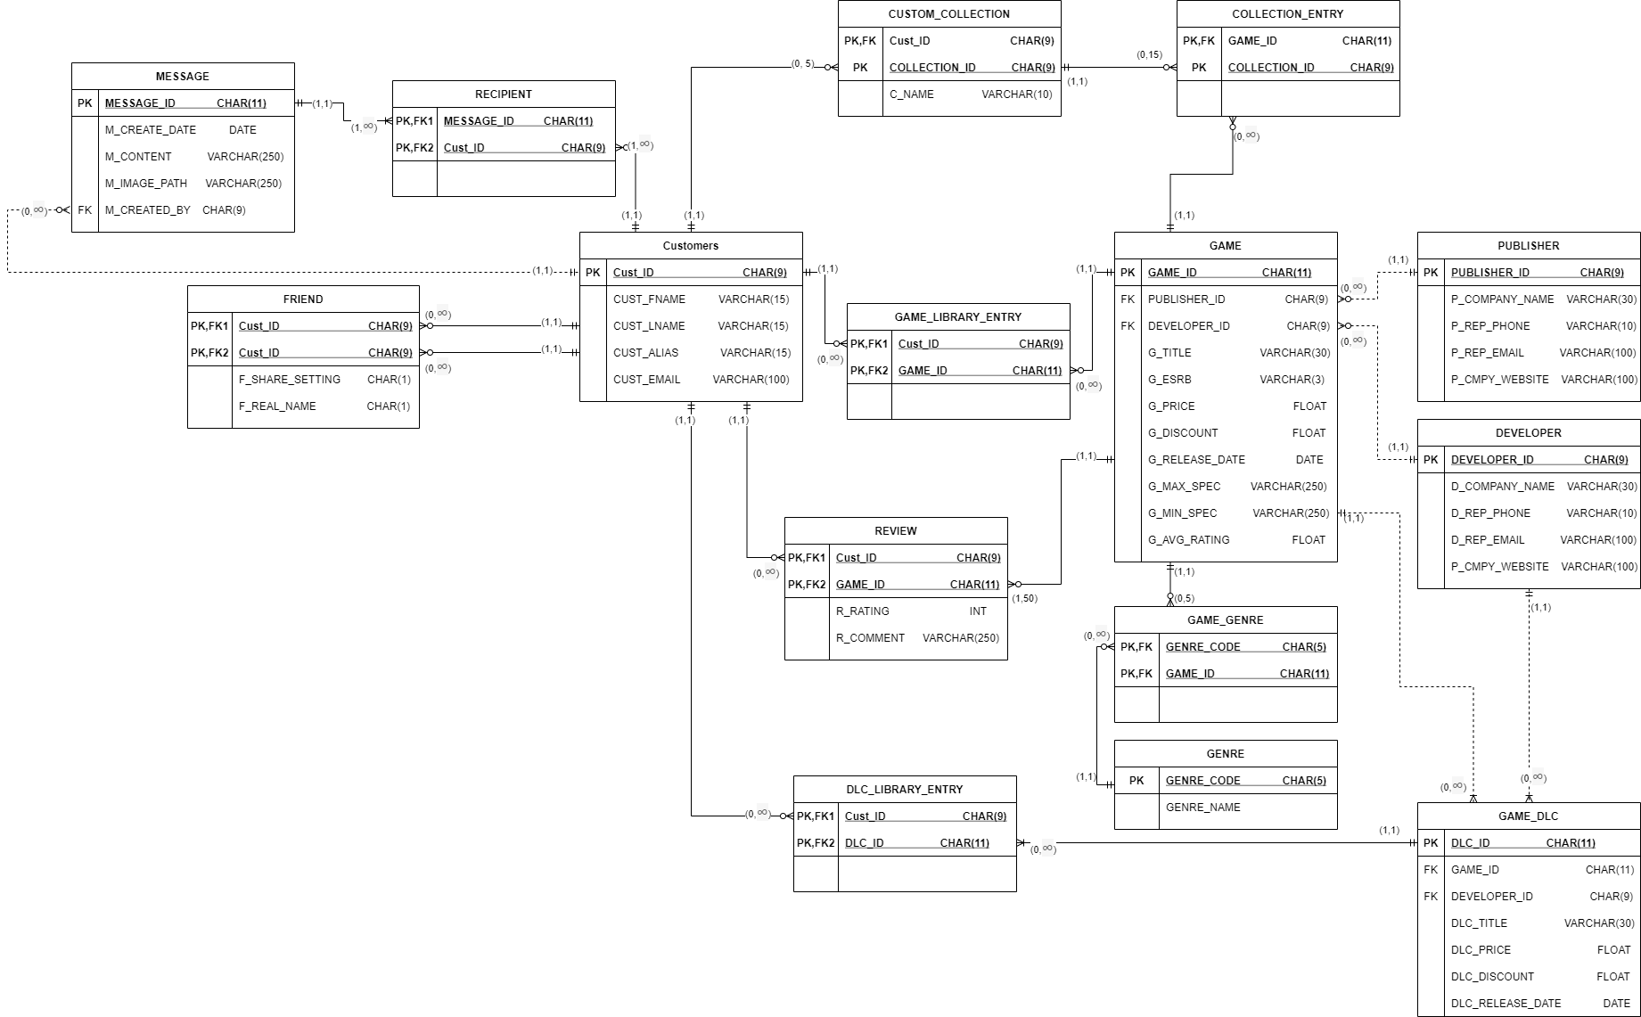
ERD/Schema

Slide 8
Views

Slide 9
Triggers - Queries

